Slide 1
Code Reviews
Finding Bugs
Notes:
<number>

Slide 2
Testing Principles
Check compliance with requirements
Check compliance after changes (regression)
Methodology to isolate problems
Reduce costs of maintenance
Notes:
<number>

Slide 3
Good practices
Requirements are clearly testable
Components are easily divisible into individual pieces
Write tests offline
Create tests for ranges of values and boundaries
Create tests for types
Create tests for multiple states
Think of all the extremes

Slide 4
Types of Test
Functional
Behavioral
Performance
Integration
System
What types of tests we could write

Slide 5
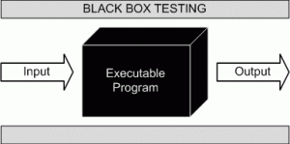
Functional Test

Slide 6
Triangle Example
A programmer wrote the following function for a math library. Come up with some test cases for the function defined below. Hint: there can be up to 21

Slide 7
Triangle Example
A programmer wrote the following function for a math library. Come up with some test cases for the function defined below. Hint: there can be up to 21

Slide 8
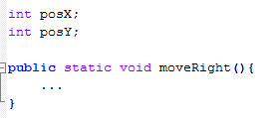
Behavioral Test (state)

Slide 9
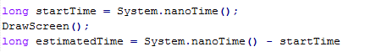
Performance Testing

Slide 10
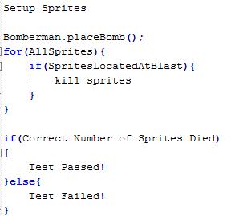
Integration Testing

Slide 11
JUnit
Getting Set up
Testing Library

Slide 12
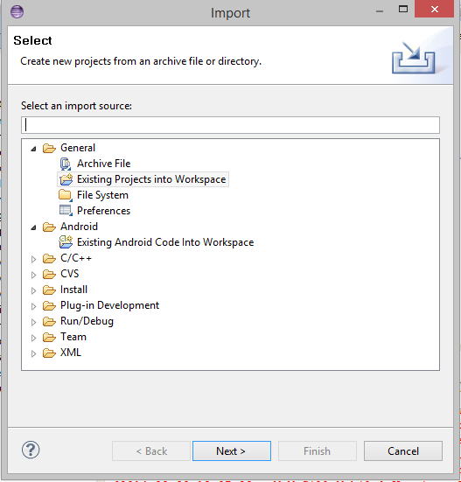
Importing a project
File -> Import -> Existing project into Workspace -> Browse for project

Slide 13
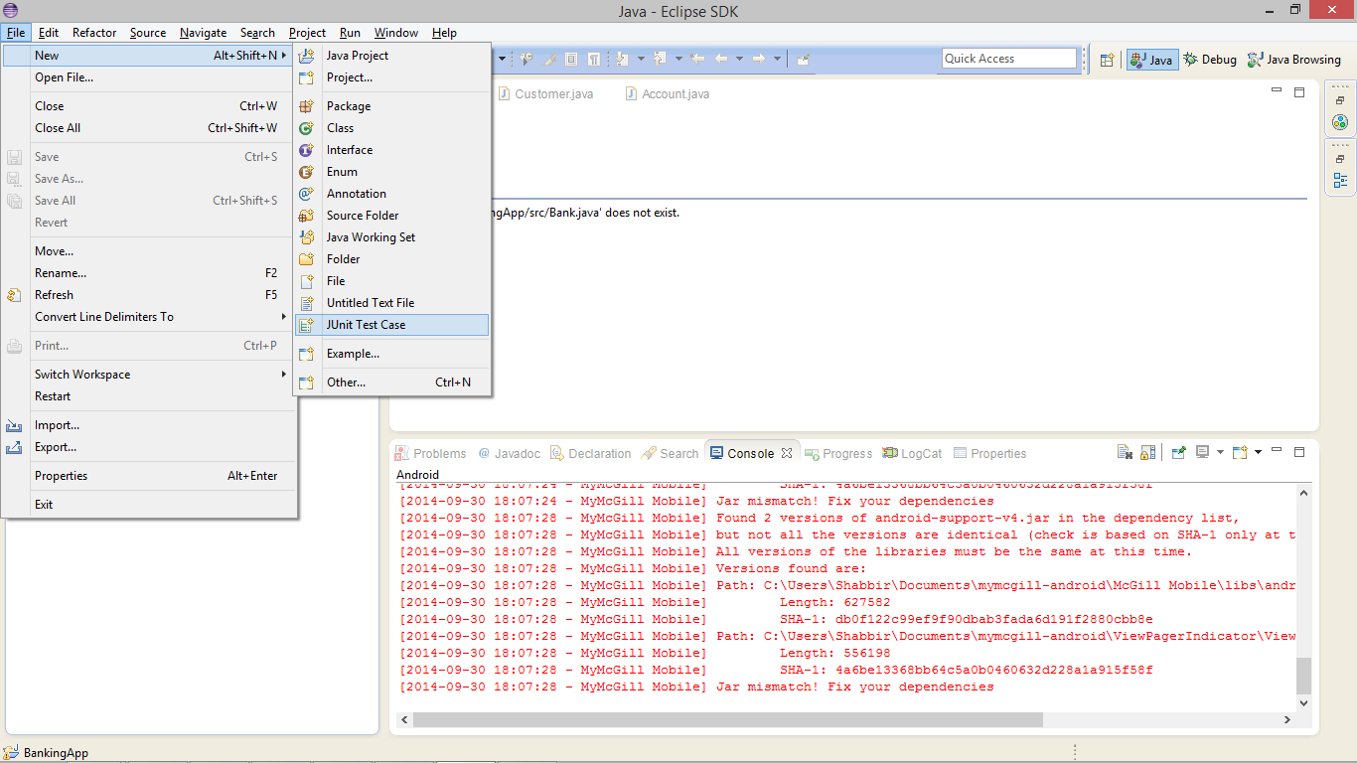
Setting up a Test
File -> new-> Junit Test case

Slide 14
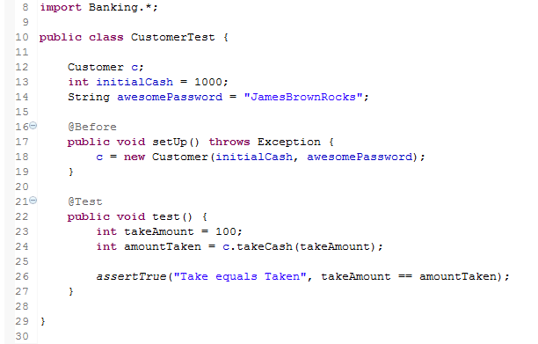
Junit Structure
Import Classes under test
Declare Objects under Test
Flag to execute this method before test
Flag to indicate this method is a test case
Assertion decides if test will pass or fail

Slide 15
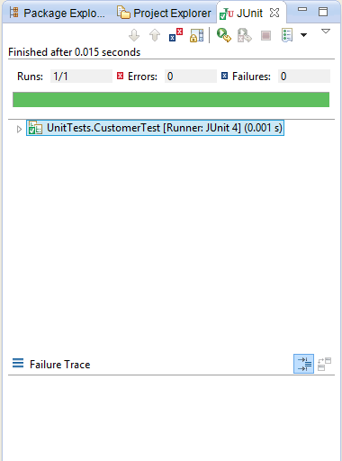
Running Tests
Right Click on Test class -> Run as -> JunitTest

Slide 16
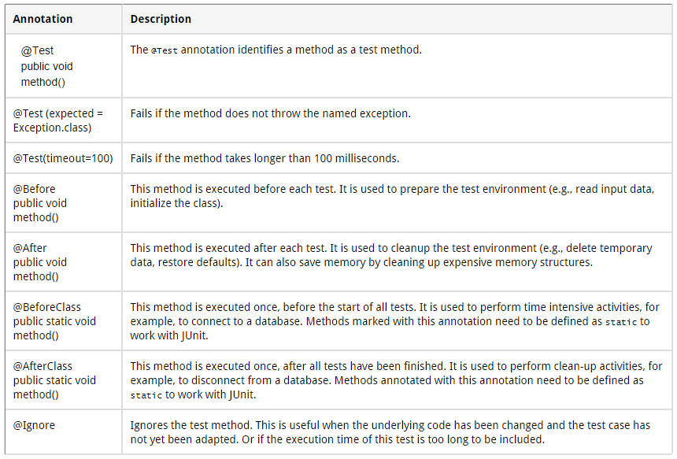
Junit Annotations
Notes:
Taken from http://www.vogella.com/tutorials/JUnit/article.html
<number>

Slide 17
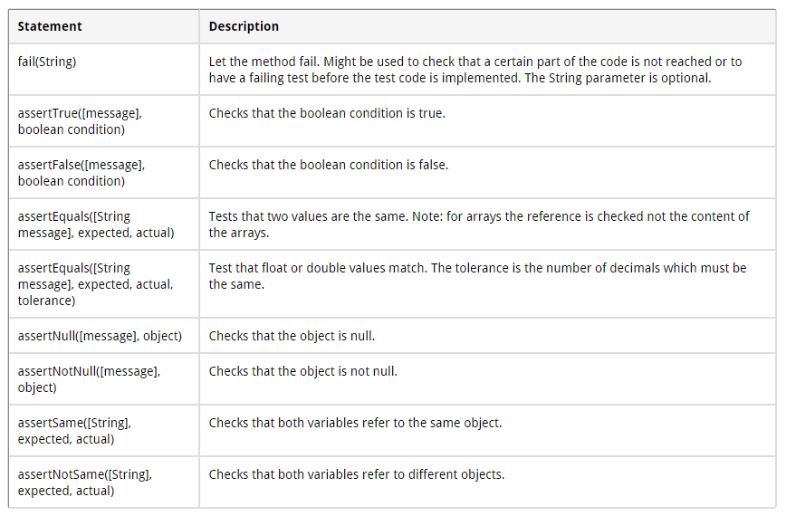
Junit Assertions
Notes:
Taken from http://www.vogella.com/tutorials/JUnit/article.html
<number>

Slide 18
Concept questions
You work for a company that sells a desktop app that millions of customers use. 10% of your customer base complains that the app crashes every Tuesday morning. How do you start your investigation?

Slide 19
Concept questions
You are writing a java program and notice a bug. You put a print statement in your code to diagnose the bug. The bug disappeared. What could have happened

Slide 20
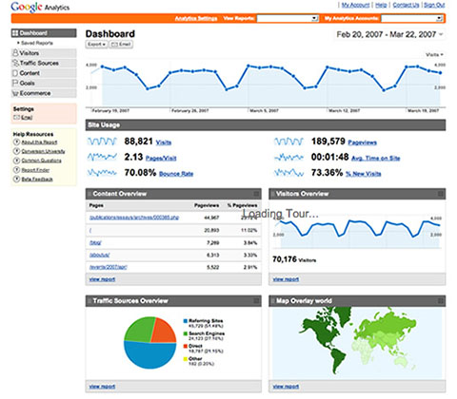

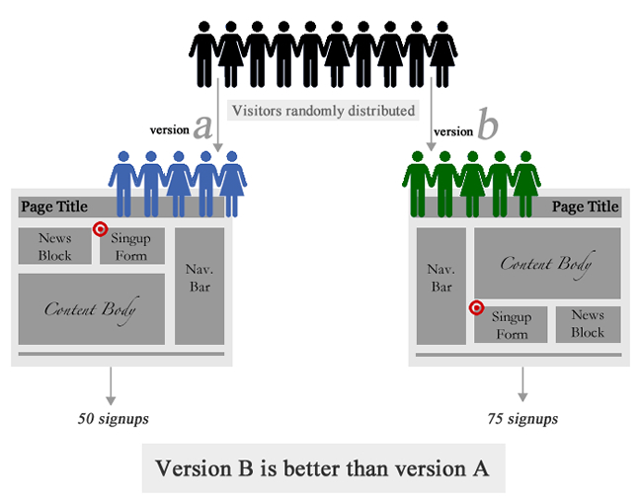

Alternative Testing Methods

Slide 21

Alternative Testing Methods

Slide 22
Code Reviews
Manually Reading Code
Using Expertise rather than automation

Slide 23
Code Reviews
Are there any logical errors?
Is the algorithm correct?
Is it understandable?
Is it properly commented?
Are comments Meaningful?
Are the spacings correct?
Are members private?

Slide 24
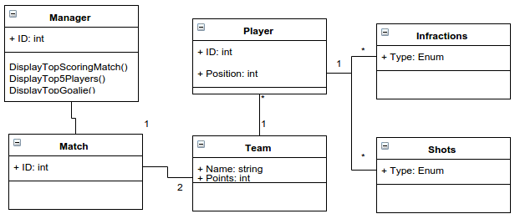
Exercise
Fork Project at :https://github.com/shabbir-hussain/SoccerStats
Notes:
<number>

Slide 25
Exercise
Add a method to display top goalie, and methods to display top scoring matches and top 5 players (print statements are enough)
Notes:
<number>

Slide 26
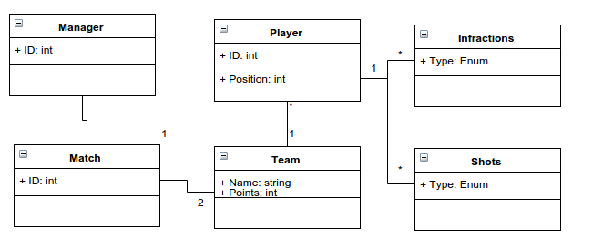
Exercise
Instantiate 6 matches between 4 teams (make up the numbers) in order to test The 3 display functions
Notes:
<number>

